Slide 1


Slide 2
1. The mini-c level of creativity
Creativity is inherent in learning.
Any time one attempts a new task, there is a level of creativity involved.
At the mini-c level of creativity, what one creates might not be revolutionary but it is new and meaningful to them.

Slide 3
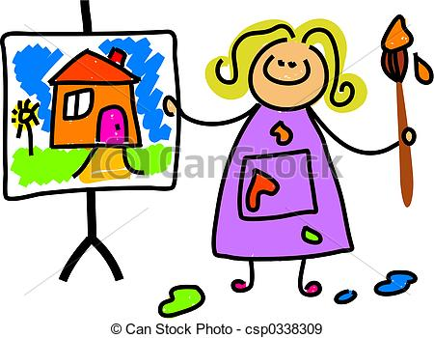
Example: Jacob, a 5 year old kid, brings home his first painting from school. It is his first attempt to be appropriate to the task and it is new and meaningful to him.

Slide 4
2. The little-c level of creativity
The little-c level of creativity reflects an aspect of growth from the mini-c level.
With appropriate feedback, advancements are made and what was created might be of value to others.

Slide 5
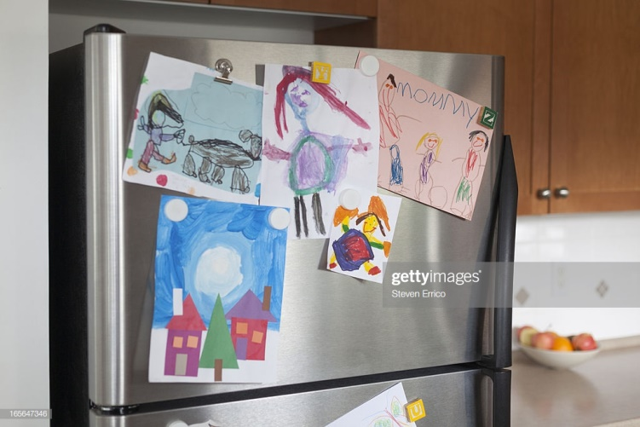
Example: Jacob’s parents love the new painting Jacob brought home today. They place it on the refrigerator because they think it is good and they get enjoyment out of seeing it. It’s on its way to becoming art.

Slide 6
3. The Pro-c level of creativity
At this level, one has the ability to be creative at a professional level and in a professional venue.
At this point, one would have had many years of deliberate practice and training.
Not everyone at the Pro-c level can make a living with their creative pursuit; however, it is generally the goal of those at this level to support themselves doing something they love.

Slide 7
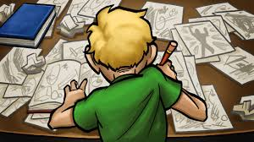
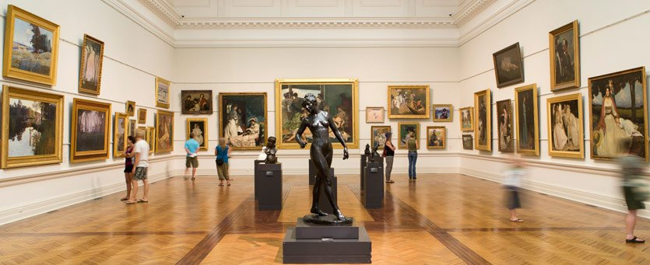
Example: Jacob majored in art in college and his pictures now hang in galleries. His paintings are recognized by art experts and critics as being creative. His paintings hang in the homes of others—not just his friends and family, but people who do not know Jacob personally but who appreciate and are moved by his art.

Slide 8
4. The Big-C level of creativity
Those at the Big-C level will be remembered in the history books.
The Big-C level includes an evaluation of one’s entire career and entire body of work and then evaluates the entire body of work against other great contributors and decides where one fits in.

Slide 9
Example: Over the years, Jacob’s paintings have been bought by people who have tremendous collections of artwork. His paintings hang in famous galleries and are regularly discussed by experts. Decades from now, Jacob will be considered one of the greatest artists of all time.

Slide 10
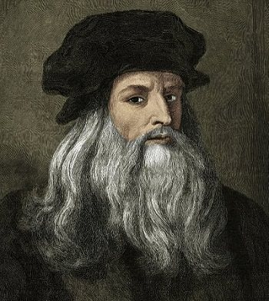
Leonardo da Vinci

